Slide 1
Mapping Healthcare Access Gaps in Nairobi County
2025/26

Slide 2
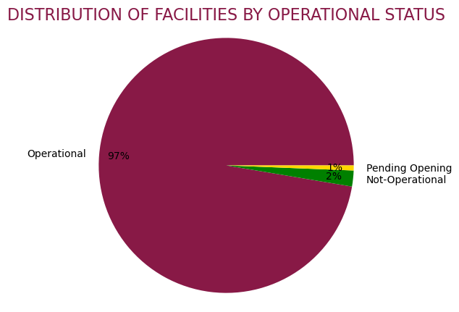
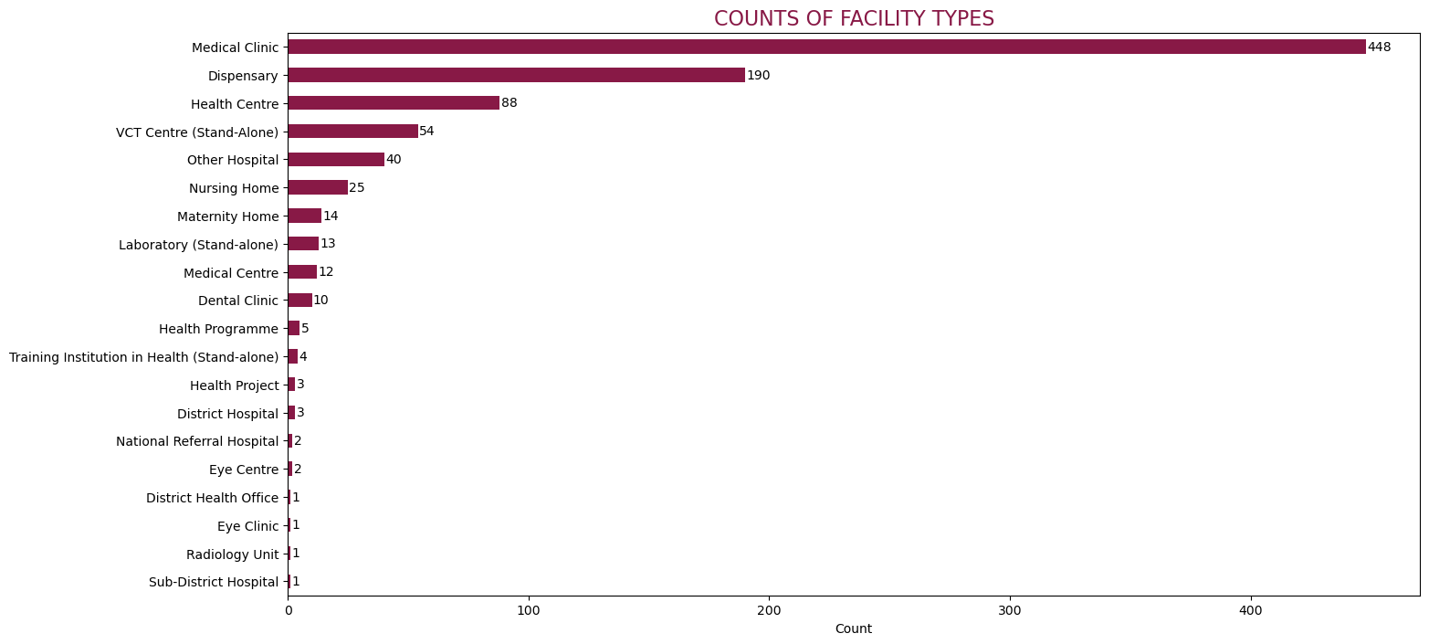
Universal Health Coverage
SDG Target 3.8 aims to achieve universal health coverage which includes access to effective and quality healthcare for all.
Facilities Distribution:
Key Findings
Out of 942 health facilities in Nairobi, 19 are closed and 6 are pending opening which presents untapped capacity.
Medical clinics and dispensaries dominate the healthcare landscape accounting for approximately 70% of all facilities.
There are very few higher-level facilities (district/national referral hospitals) meaning there is limited access to specialised care.
Recommendations
Prioritise reopening of the 19 closed facilities, especially Our Lady of Lourdes Mwea Hospital in Embakasi which is already equipped with beds, cots, and operates 24 hours.
To strengthen primary care access, expedite the opening of the 6 pending outpatient facilities.

Slide 3
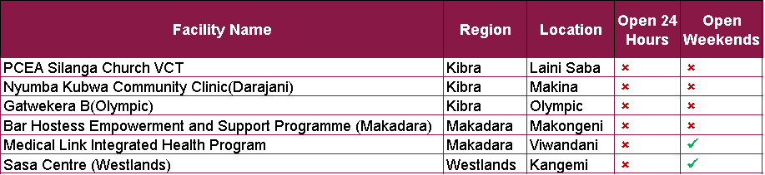
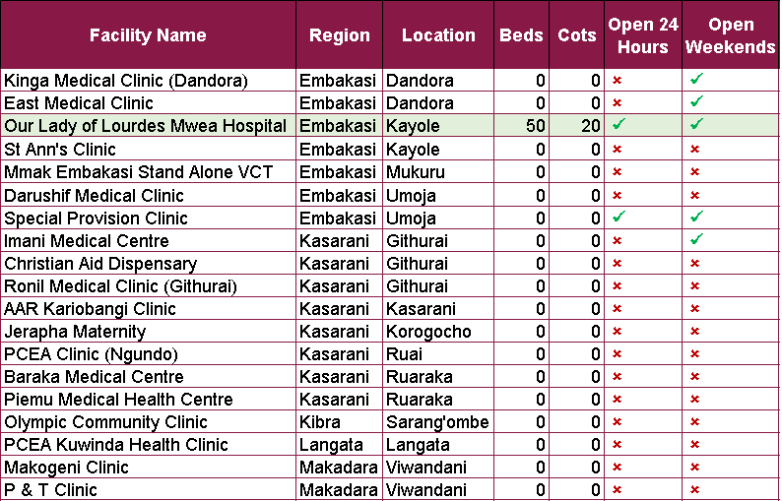
Universal Health Coverage (cont…)
Facilities Distribution:
Pending Opening:
Non-Operational Facilities:
To meet Nairobi’s average levels of inpatient and home-based care services per capita, the following regions need additional facilities that offer inpatient (IPD) and home-based care(HBC):
Region | Population | Current IPD | Target IPD | New IPD Required | Current HBC | Target HBC | New HBC Required
Westlands | 308,854 | 17 | 21 | 4 | 14 | 18 | 4
Embakasi | 988,808 | 55 | 65 | 10 | 34 | 56 | 22
Kasarani | 1,407,138 | 52 | 93 | 41 | 46 | 79 | 33
Mathare | 206,564 | 5 | 14 | 9 | 8 | 12 | 4

Slide 4
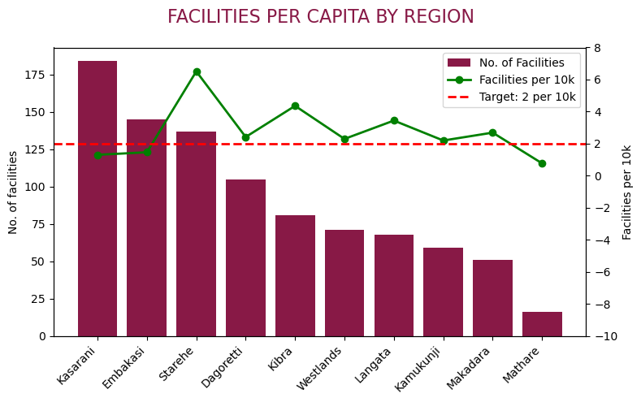
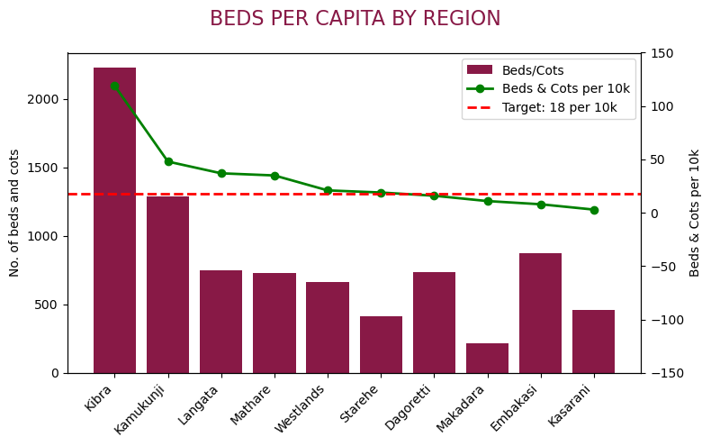
Universal Health Coverage (cont…)
Facilities Distribution:
Key Findings
In terms of facilities per capita, the 3 most underserved regions are Mathare, Kasarani, and Embakasi all with under 2 facilities per 10,000 population.
Dagoretti, Makadara, Embakasi, and Kasarani have less than the recommended 18 beds per 10,000 population.
There are no cots in Mathare indicating a critical gap in neonatal/paediatric care.
Recommendations
To reach the 18 beds/10,000 target, at least 2 facilities/10,000, and be able to provide basic neonatal care in all regions:
Mathare: needs 26 additional facilities and 53 cots
Kasarani: needs 98 additional facilities and 2,074 additional beds
Embakasi: needs 53 additional facilities and 909 additional beds
Dagoretti: needs 44 additional beds
Makadara: needs 128 additional beds

Slide 5
Neonatal and Child Mortality
SDG Target 3.2 aims to reduce neonatal mortality to at least as low as 12 per 1,000 live births and under-5 mortality to at least as low as 25 per 1,000 live births.
To support this goal, the County should prioritise improving access to Community Integrated Management of Childhood Illness (C-IMCI) by adding C-IMCI services in the following regions currently below average:
Region | Population | Current C-IMCI | Target C-IMCI | New C-IMCI Required
Kibra | 185,777 | 3 | 4 | 1
Makadara | 189,536 | 3 | 4 | 1
Embakasi | 988,808 | 9 | 17 | 8
Kasarani | 1,407,138 | 7 | 24 | 17

Slide 6
Communicable Diseases
SDG Target 3.3 aims to end the epidemics of AIDS, tuberculosis, malaria, neglected tropical diseases, combat hepatitis, water-borne diseases, and other communicable diseases by 2030.
To help achieve this, Nairobi County should prioritise improving access to antiretroviral therapy (ART) services by adding these services in the following regions currently below average:
Region | Population | Current ART | Target ART | New ART Required
Dagoretti | 434,208 | 10 | 11 | 1
Westlands | 308,854 | 7 | 8 | 1
Embakasi | 988,808 | 12 | 25 | 13
Kasarani | 1,407,138 | 21 | 35 | 14
Mathare | 206,564 | 5 | 6 | 1

Slide 7
Sexual and Reproductive Health
SDG Target 3.7 aims to ensure universal access to sexual and reproductive health-care services, including family planning, information, education, and integration into national strategies by 2030.
To support this, the County should prioritise expanding family planning (FP) services by adding these services in the following regions currently below the county average:
Region | Population | Current FP | Target FP | New FP Required
Westlands | 308,854 | 15 | 20 | 5
Embakasi | 988,808 | 54 | 62 | 8
Kasarani | 1,407,138 | 51 | 88 | 37
Mathare | 206,564 | 5 | 13 | 8

Slide 8
Thank You

